Slide 1
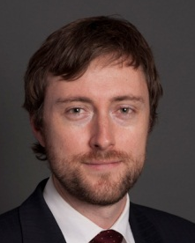
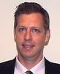
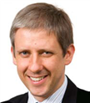
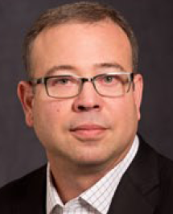
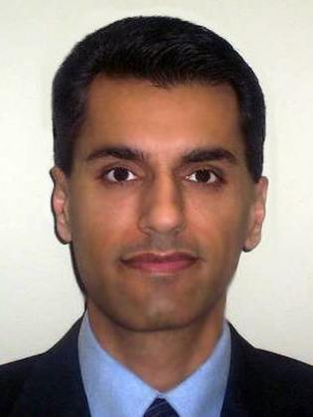
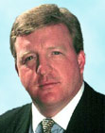
Capturing Alpha in
High-Performance Trading
Michael Henderson
Chief Architect
Direct Edge
Neal Secher
Executive Director
Morgan Stanley
Raymond Russell
CTO
Corvil, LTD
Paul Perez
VP and CTO
Data Center Group Cisco Systems
Dave Malik
Senior Director
Solution Architecture
Cisco Systems
Paul Jameson
Sr. Director Global Financial Services
Cisco Systems
(Moderator)

