Slide 1

Session 6: Moderator: William Adiletta – Capco Technology Partner
Datacenter Strategies Leverage the Extraordinary High Volume of Wall Street Data:
Storing, accessing, analyzing - cost effectively
Data center strategies mandate cost/benefit analysis, legacy issues, regulatory requirements, data governance, and leveraging data analytics to offset increasing costs of operation.

Slide 2
Introductions
Moderator:
William Adiletta – Capco Technology Partner
Panelists:
Michael Wacey – Capco Managing Principal
Doug Rich – SME General Manager, Americas
Michael Stemmler – Cloud Partners Managing Director

Slide 3
Agenda:
Datacenter Strategies Leverage the Extraordinary High Volume of Wall Street Data: Storing, accessing, analyzing - cost effectively
Explosive Data Growth – “Big Data”
New Technologies to address Data Challenges
Storing / Accessing / Analyzing
Regulatory Compliance
Securing
Cloud Services

Slide 4
Explosive Data Growth
spending on data technologies to increase from 23.8% of IT spending today to 27.7% over the next three years
data growth is expected to accelerate from 40% in 2012, to over 50% given new apps, cloud services, mobile devices, and emerging technologies
for enterprises with a Big Data strategy, spending on data technologies is expected to increase by over 25% yearly

Slide 5
More Growth Trends
data management is a dominant driver of business models and competitive advantage
fundamental change in data management is to store and analyze any data set — any type of data, any size of data set, from any type of user/device, and in any timeframe
demand for actionable intelligence to drive business models and an accelerating pace of data growth
IT to shift more dollars towards data technologies over the next three years
new Apps, Mobile Devices, Cloud Computing are fueling an acceleration of data growth to 50%+ from 40%

Slide 6
New Technologies address Data Challenges
In a recent MS survey 30-40% of respondents expect to use new vendors for next generation data technologies and the number of technologies in use is expected to roughly double

Slide 7
New Technology Example Regulatory Compliant Cloud Storage: FinQloud
FinQloud from NASDAQ OMX is a secure, cloud computing platform designed for, and accessible exclusively by, the financial services sector that combines AWS cloud computing expertise with exchange-grade security to provide cost-effective and efficient management and storage of financial data mandated by regulation.
FinQloud helps firms reduce the operational costs and complexities associated with data and infrastructure management.
FinQloud enables financial market participants to benefit from the economic and performance features of cloud computing, while still meeting stringent regulatory and security requirements.
FinQloud is fully-managed and designed to immediately help firms reduce their technology burden, aid in compliance and refocus resources on revenue driving activities, even as data volumes and regulatory initiatives continually rise.

Slide 8

How FinQloud Leverages AWS
FinQloud
Cost-effective Data Storage (S3)
Regulatory Records Retention (R3)
“Cold” Data Storage (Glacier)
Complete AWS Suite of Compute Solutions
Ability to Leverage 3rd Party Integrators
Tailored for Financial Markets
Industry-specific Provider MarketPlace
Long Term Contract Commitments
Amazon Web Services
Cost-effective Data Storage (S3)
Regulatory Records Retention (R3)
“Cold” Data Storage (Glacier)
Complete AWS Suite of Compute Solutions
Ability to Leverage 3rd Party Integrators
Tailored for Financial Markets
Industry-specific Provider MarketPlace
Long Term Contract Commitments
FinQloud provides Participants with the ability to consume AWS services/solutions at AWS published prices, with the added benefits of services/solutions purpose-built for financial markets participants that are not available outside the platform – all at no additional cost.

Slide 9
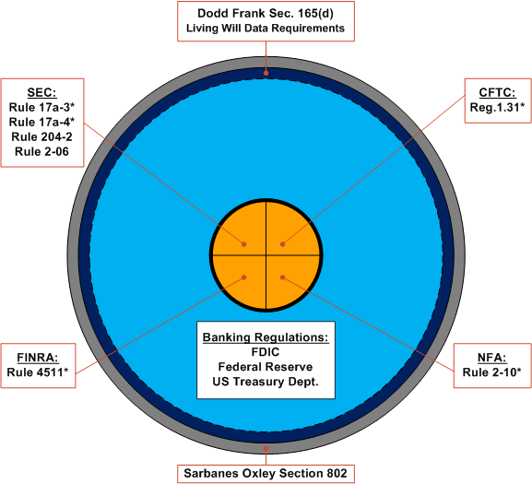
Regulatory Records Retention (R3) Data Storage
Designed to meet the regulatory obligation of broker-dealers and other financial market participants to store data on Books & Records compliant media.
Represents the next generation of “write once, read many” (WORM) compliant storage solutions.
Includes the use of Query, the search and retrieval tool that is a companion offering to FinQloud’s StrongBox data storage solutions.
Two independent 3rd parties have conducted in-depth technical assessments of R3’s ability to meet the data storage and retention requirements of SEC Rule 17a-4, the positive results of which will be published in Q1 2013.
Financial Data Storage & Related Regulations
*These rules explicitly require use of non-rewritable, non-erasable data retention/management systems often referred to as “Write Once Read Many” or “WORM.” While the Sarbanes-Oxley Act of 2002 (“SOX”) does not explicitly require WORM, it encourages use of WORM or similar technology as a means of avoiding criminal penalties with regard to altering, destroying, mutilating, concealing, covering up, or falsifying any record or document under Section 802 of SOX.
- Datacenter Strategies

Slide 10
BYOD is evolving into BYOC – Cloud Sprawl
  IT under pressure from business to support a flexible Smart Device driven infrastructure
  Proliferation of Smart devices hard to manage and support
  Data exists in Silos amongst Cloud Services, internal Apps and Messaging services
    Hard to locate or search amongst corporate data
    More data being stored in non traditional data sources (Dropbox, Box, Google Drive, etc.)
    Although data exists in email or archive it is “stuck” and not visible

Slide 11
My Cloud is better than your Cloud !
  SaaS Service Providers competing for you to move your data from one silo to another
    and invariably it is not easy to move
    and more are popping up every day…especially in the Cloud Storage space
  Companies show that they will potentially try and move provider / data based on just one feature missing
    “We want DropBox replication”
    “We can’t work with the DropBox files on iWork on our iPad”
    “Our Core business Apps need FTP support”

Slide 12
And what about legislation ?
  Legislation evolving and will become stricter
  How do you add governance amongst the distributed sprawl of public / private cloud services
    HIPAA, FERPA, PCI, SOX, etc.
    and more are popping up every day…especially in the Cloud Storage space
  What about Country specific legislation ?
    Patriot Act
    Legislation regarding data staying within country borders ?
      Canadian Public Sector or Government body
      Australian business laws on customer privacy
      etc.

Slide 13
Storage Made Easy
Storage Made Easy provides a secure, audited, file synchronization and collaboration platform that unifies Cloud and On-premise file sources and can be deployed on-site as well as being externally hosted, and that is accessible from all major operating systems and mobile devices.
Centralized e-compliance,
Audit,
BYOD
Centralized Search,
Permissions
Unifying
public/private clouds
Unified data view
Single management / search
(users / permissions / sharing)
April 2013
Notes:
Layered around the unification concept
Bottom
Devices and software packages
Includes search

Slide 14
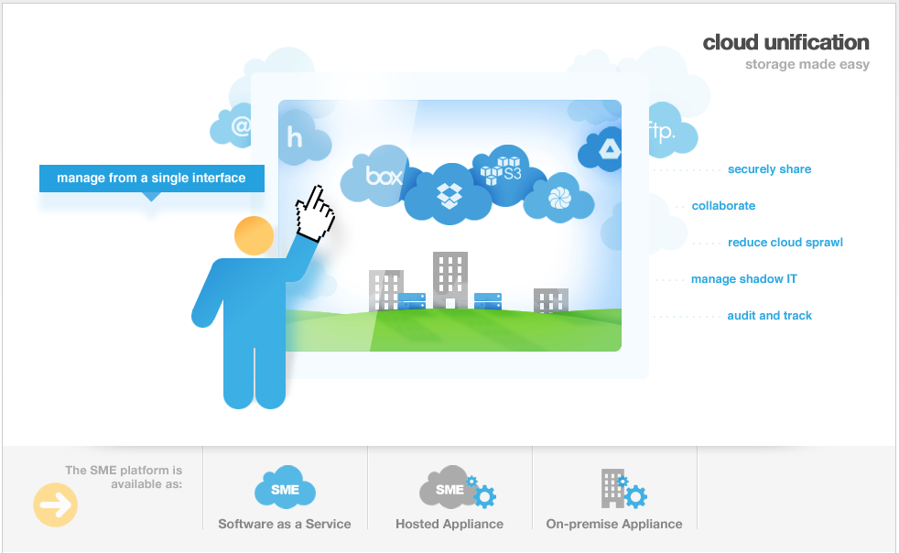
“Single Pane of Glass” View of all Storage Silos

Slide 15
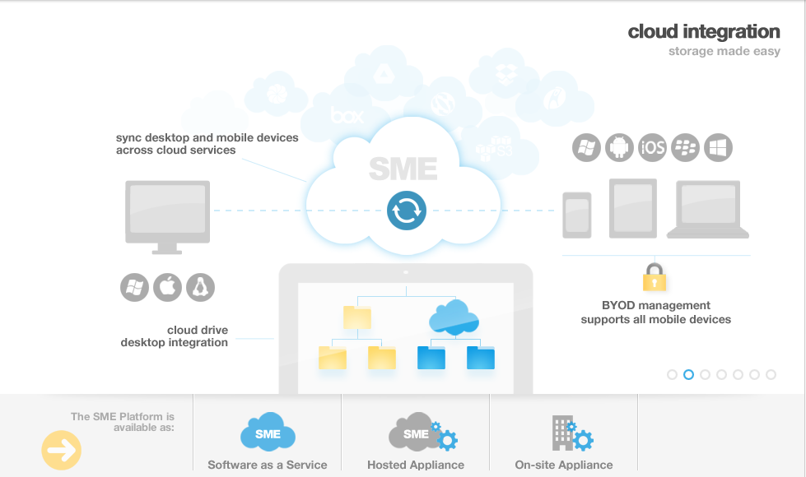
Secure, Audited File Synchronization and Collaboration from Web, Desktop or Mobile

Slide 16
Using Big Data
Explosive Growth of Data
  Keep it all – you never know what will be needed
  Use relatively inexpensive commodity hardware or the cloud
New Business Models
  Predictive Analytics
  Fraud Detection
  Policy Violations
New Technology
  Existing Players – SAP, IBM, Oracle
  New Players – Cloudera, Apache, Nebula, Amazon

Slide 17
Explosive Growth of Data
Query
Queries quickly become more complicated than planned and require a high degree of expertise in the user community.
Results in a specific set of highly controlled data that meets defined users needs.
Query
Source
Analyze, Process, Validate, Audit,
Load
Data Mart
Data Warehouse
Query
Source
Data Mart
Source
Results in all data being available but queries must address data quality, audit, and integration.
Big Data Repository
Query
Source
Query
Leverage inexpensive storage and high speed of big data parallel query processing
Source
Query
Source
Notes:
Current queries are not that simple and require a high level of expertise in the user community.
Current approaches take time to process and put delays in getting data out.
Current approaches cannot deal well with changes in source data or changes in data needs.
Current approaches cannot deal well with changes in needs for historical data – requires all the data to be processed.

Slide 18
Explosive Growth of Data
Hadoop is based on relatively low cost servers running open source software connecting over standard networks
Results in low cost per GB implementations
Redundancy handles the need for resiliency
Vendors are offering support and management options to make Hadoop enterprise class
Companies are seeing up to 50% cost savings by leveraging cloud based Big Data – will not work for every organization, but the cost savings can be compelling
Reducing storage cost can be used for savings or for additional storage availability

Slide 19
New Business Models
Google was created in part by leveraging big data technologies
The early use case for big data was web log searches
The uses are expanding each day
Look for things that were considered undoable a few years ago

Slide 20
New Business Models
Predictive Modeling
  Massive independent variable analysis
  Interactions across all variables
  Running simulations of results (requires generation of massive data quantities)
  Enabling Technologies: Hadoop and R

Slide 21
New Business Models
Fraud Analysis
  Analysis of all data in flight – not just selected data
  Compare each new transaction against all history
  Enabling technologies: SAP Hana
Policy Violations
  Will this fee waiver put this customer outside of three standard deviations of all fee waivers for like customers?
  Policies are often stated in terms that require comparison to a large set of data
  Enabling technologies: IBM Infosphere Streams

Slide 22
Public and Private Cloud Benefits
On-demand…through self-service interfaces
Elastic…dynamically scales up and down
Shared…pooled resources
Metered by use…at a high level of granularity
Accessible…broadly over the network

Slide 23





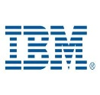

Today’s Cloud Options and Challenges
Use Public Cloud
Limited security controls
Lock-in
High ongoing costs
Flexibility
Build Custom Private Cloud
Implementation risk
Deep expertise required
Implementation cost
Ongoing support cost
Buy Packaged Private “Cloud”
PureSystems
High upfront cost
High ongoing support cost
Vendor Lock-in
Not scalable
Notes:
Yesterdays most expensive technologies integrated by today’s most expensive consultants.

Slide 24

Framing the Challenges
Security & Compliance
Private Cloud
Adoption
Financial Pressures
Pressure for
Business Agility
Big Data
Explosion
Scale-out
Architecture

Slide 25
Policy-driven governance is an enterprise requirement
Without policies:
  Wrong Permissions
  Unsecured data
  No Audit trail
  Accessing wrong environments
  Approval Delays
With policy-driven Governance and Orchestration:
  Lifecycle management
  Optimization of workloads
  Policy-controlled Self Service
  Efficient reporting
  Faster “time-to-value”

Slide 26


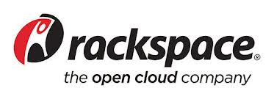
Open Source
Unlike the competition, Hortonworks embraces the open-source approach and is led by the people who actually created Hadoop.
As the founders and creators of OpenStack, we are uniquely positioned to rapidly create the most innovative private cloud platform. Nebula offers elastic scalability with commodity compute and storage nodes. Scale out, not up.
Rackspace Cloud Software is powered by OpenStack. Because their Private Cloud Software is based on open-source technology, you don't have the risk of being locked into a proprietary platform.

Slide 27


Performance
RainStor has the highest compression ration on the market today – up to 40X!
RainStor’s compression technology drastically reduces the number of clusters to run your Hadoop infrastructure.
XtremeData’s DBX software product is the only high-performance, low-cost, SQL database designed for Big Data and operates on a cloud, or virtualized environment. This technology also provides up to a 60% reduction in TCO.
Unlike the expensive appliances that have dominated the market, Xtreme’s solution is scalable and leverages cloud computing infrastructure, while out-performing the market.

Slide 28


Optimization
VI provides real time performance metrics at the I/O level allowing for information to be gathered like never before.
Optimizing the underlying infrastructure and SAN environment delivers material benefit to the enterprise in both performance and cost efficiencies.
Automates the deployment and management of enterprise applications across private, public and hybrid cloud environments
Enforces governance, compliance and security across the full lifecycle of cloud applications
Empowers the business with on-demand, self-service access to enterprise cloud applications, platforms, and services

