Slide 1


www.officetools.com

Slide 2





Four things to
know about
Perfect
workflow

Slide 3


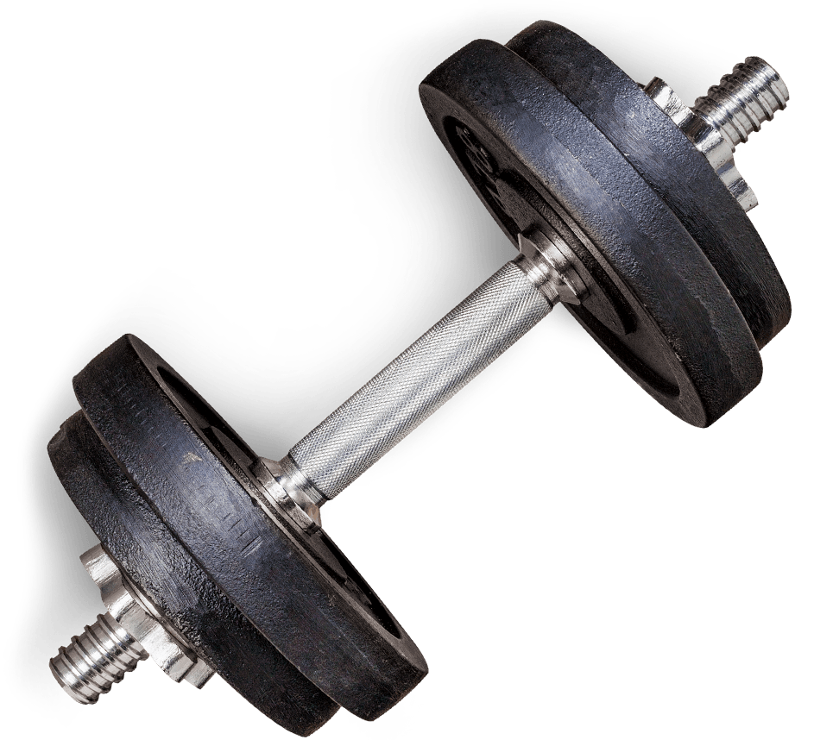
THE POWER IS YOURS
Harness your firm’s potential
The most comprehensive
practice management solution
in our market today

Slide 4



Slide 5



Slide 6


Get your FREE print copy at
www.myofficetoday.me
PROVIDING INSIGHT TO ACCOUNTANTS
Print distribution
25k
Online distribution
75k
Includes select
articles and software reviews from industry thought leaders & vendors.

Slide 7




Four things to
know about
Perfect
workflow

Slide 8




This session will provide you with guidance on reviewing your workflow systems and policies.
We will also detail Four specific stages that can help your firm develop and maintain perfect workflow.

Slide 9

If running a firm was easy…

Slide 10


…and everything ran smoothly…

Slide 11

…my life would be great.

Slide 12
Don’t you wish your firm was working flawlessly…

Slide 13
…so you could get back to building something great?

Slide 14
Building The Dream Office

Slide 15

MAKING SENSE
OF CHAOS

Slide 16


Slide 17
PERFECT YOUR WORKFLOW
Are you aware that by creating perfect workflow you can save up to an hour of time per team member per day?
Lets see, for each individual that’s 5 hours a week
and around 250 hours a year.
What's the reduction of costs?
What’s the increase in new opportunity?

Slide 18
PERFECT YOUR WORKFLOW
Workflow has evolved from the simple task manager or due date monitoring systems of the past
to congregated, comprehensive office management systems that can organize every type of work you do.
Workflow has been affected by new automations in document handling, tax preparation and advisory services.
We are seeing options range from standalone workflow systems to complete firm management systems
and the choices are endless.

Slide 19




DEFINE
Take time to evaluate
what workflow is
by including your team
and asking questions

Slide 20

DEFINING YOUR WORKFLOW
First ask questions?
What should I track?
Do I still have paper in my workflow?
Is tax workflow the only thing I do?
How much workflow do I need if it is just me?
How do I handle staffing issues?
What is the best way to handle client needs?
Should I track all my client communications?
Does email drive you crazy? Include it.
DEFINE

Slide 21
DEFINING YOUR WORKFLOW
Are phone calls, notation or client appointments trackable?
Do I need multiple programs to manage workflow?
What integrations are important to me?
Am I doing all the bookkeeping?
Am I proactive and working as a advisor or am I still providing historical compilations?
Do I provide financials, payroll, sales tax & other services?
Do I want a on premise or cloud environment?
DEFINE

Slide 22
DEFINING YOUR WORKFLOW
Start as broad as possible
If necessary bring in a consultant, colleague or vendor
Create a list of different services you provide
Define each unique step/process in a spread sheet
Include front office, back office and management
Place a value to the firm on each workflow 1-5
DEFINE

Slide 23
DEFINE
DISCOVER
Take time to evaluate
what workflow is by
including your team
and asking questions
Find the right tools
that best fit your
defined workflow for
each area of your firm

Slide 24

DISCOVER YOUR TOOLS
Before you can begin to find the tools you need you will need to determine if best of breed or suites are needed for each workflow you defined. Review your value assessments made in your excel sheet and then start your research.
DISCOVER

Slide 25
DISCOVER YOUR TOOLS
Attend tech conferences
Consult with colleagues
Hire a consultant
Find vendors who educate
DISCOVER

Slide 26
DISCOVER YOUR TOOLS
Tax Tools
Automated tax workflow
Scan and populate
DISCOVER

Slide 27


SCAN
FILL
POPULATE
Technology

Slide 28
Digital Repository – DMS systems
More Monitors - Vertical?
Mark Up Tools
Scan, Fill, Populate

Slide 29
Lucion - File Center
SurePrep
GruntWorx
Adobe
Cpaperless
Others

Slide 30
DISCOVER YOUR TOOLS
Tax Tools
Automated tax workflow
Scan and populate
General Ledger to Tax Integrations
Client portals
DISCOVER

Slide 31

Client
Portals

Slide 32
Sending docs & eSignatures
Creating a client experience
Communications; status updates
Appointment request and reminders
Questionnaires; Organizers
Client updates info & pays invoices

Slide 33
DISCOVER YOUR TOOLS
Tax Tools
Automated tax workflow
Scan and populate
General Ledger to Tax Integrations
Client portals
eSignatures
Lobby Kiosk Systems
DISCOVER

Slide 34

Lobby
Kiosk
Systems

Slide 35
Branding your firm
Setting yourself apart
Saving front office time
Decreasing work load

Slide 36
Digitally connect with clients
Set Online appointments
Online surveys
Mobile reminders

Slide 37
DISCOVER YOUR TOOLS
Accounting Software
Online or desktop
Qbo, Zero OR OTHERS
Expense tracking apps
Time tracking apps
Financial and analysis Reporting
CC statement downloading
DISCOVER

Slide 38
DISCOVER YOUR TOOLS
Office Administration Tools
Email and Calendar programs
Document processing software
Data integrations
Integrated Workflow
Practice Management Software
DISCOVER

Slide 39















Practice Management LifeCycle™

Slide 40
The Ultimate
Management
T
ool

Slide 41
Cuts down on 50% of meetings
Delegation tool
Accountability tool
Reporting tool
Center piece to the firm
Never miss a due date

Slide 42
The Ultimate
Team
T
ool

Slide 43
Quicker access to information
Reduces interruptions by 60%
Better tracking
Creates error free services
Total time savings
Productivity increases

Slide 44
DEFINE
DISCOVER
Take time to evaluate
what workflow is by
including your team
and asking questions
Find the right tools
that best fit your
defined workflow for
each area of your firm
PERFECT
Create a culture that
embraces constant
improvement with the
goals of perfection

Slide 45

PERFECT YOUR SYSTEMS
Fine tuning after implementation
Create a culture that embraces improvement with goals of perfection
Hiring the right people
Empowering the skills that exist in your team through delegation
Team building – Performance rewards
Growing leaders
PERFECT

Slide 46
DEFINE
DISCOVER
Take time to evaluate
what workflow is
by including your team
and asking questions
Find the right tools
that best fit your
defined workflow for
each area of your firm
REPEAT
PERFECT
Be prepared to review
often and adapt changes since nothing remains
the same forever
Create a culture that
embraces constant
improvement with the
goals of perfection

Slide 47

REPEAT YOUR PROCESS
Change is Inevitable
REPEAT

Slide 48

Are you willing
to change?

Slide 49
REPEAT YOUR PROCESS
Change is Inevitable
Be pliable and put in the effort
REPEAT

Slide 50

effort
Are you putting
In The time?

Slide 51
REPEAT YOUR PROCESS
Change is Inevitable
Be pliable and put in the effort
Look at new tools annually
REPEAT

Slide 52

Research
Are you making
Right choices?

Slide 53
REPEAT YOUR PROCESS
Change is Inevitable
Be pliable and put in the effort
Look at new tools annually
Review your current workflow each year
REPEAT

Slide 54

Teamwork
Are you working
Together?

Slide 55
And my life will be great.

Slide 56
WORKSPACE™ & WORKSPACE™
ONLINE DEMO

Slide 57
Four things to
know about
Perfect
workflow

Slide 58
Q & A

Slide 59
THANK YOU FOR ATTENDING
SCHEDULE A WEB DEMO AND PURCHASE
IN THE NEXT 7 DAYS AND RECEIVE
10% OFF YOUR PURCHASE.
SIMPLY MENTION THIS PRESENTATION AND DATE.
NOT TO BE COMBINED WITH ANY OTHER OFFERS.

Slide 60
www.officetools.com

