Slide 1


www.officetools.com

Slide 2
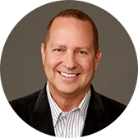
Mike Giardina
Founder, CEO

Slide 3
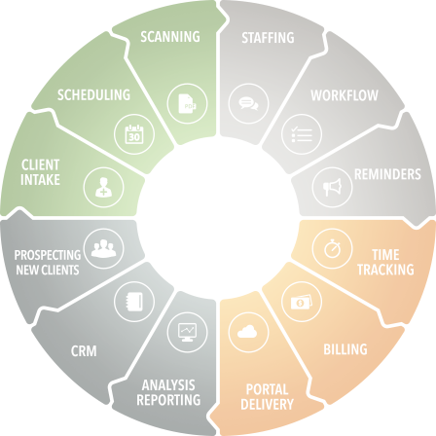

How to Automate your office on a budget

Slide 4
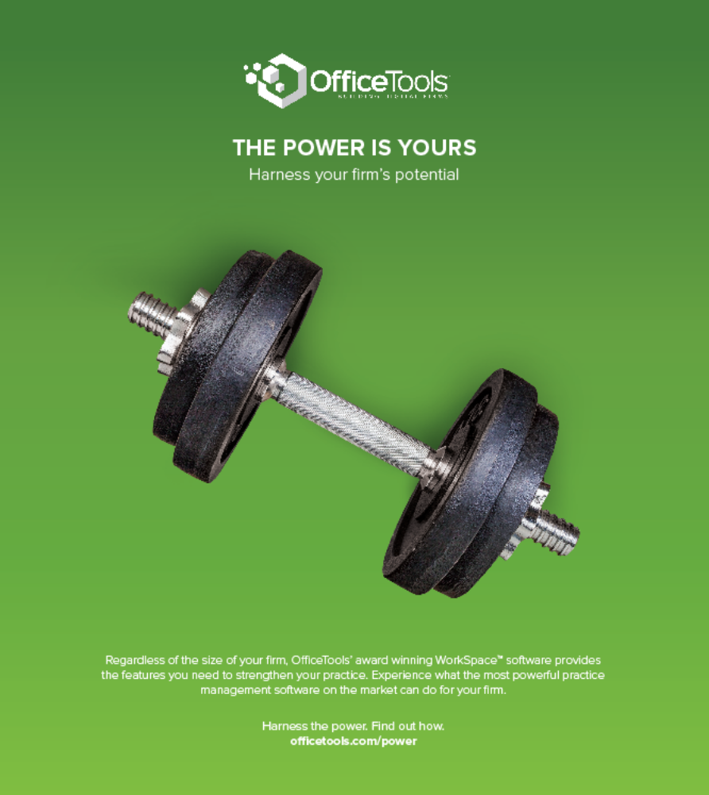
WorkSpace™
The most comprehensive practice management solution in our market today

Slide 5
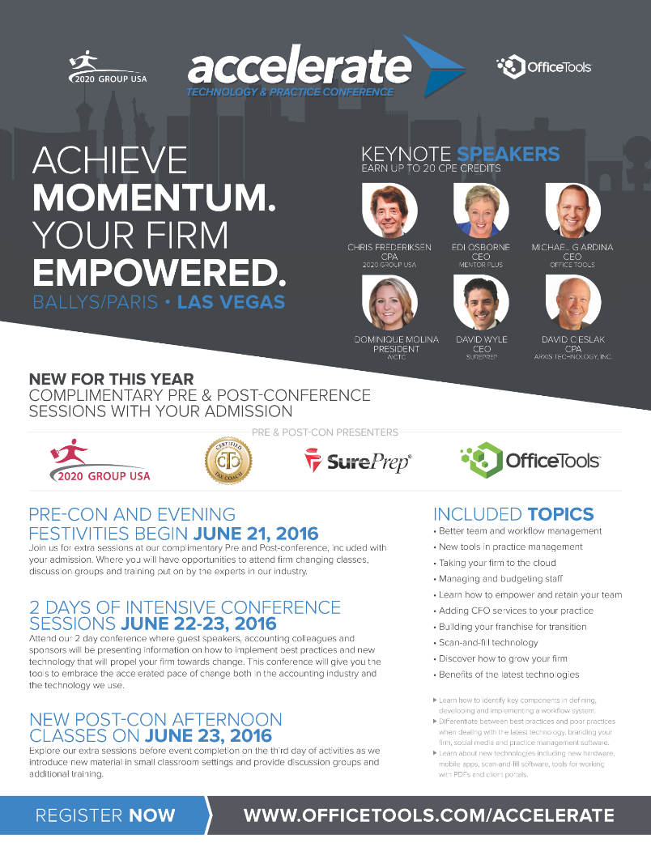
Accelerate
Tech & Practice Conference
Offering thought leadership, networking and educational opportunities

Slide 6
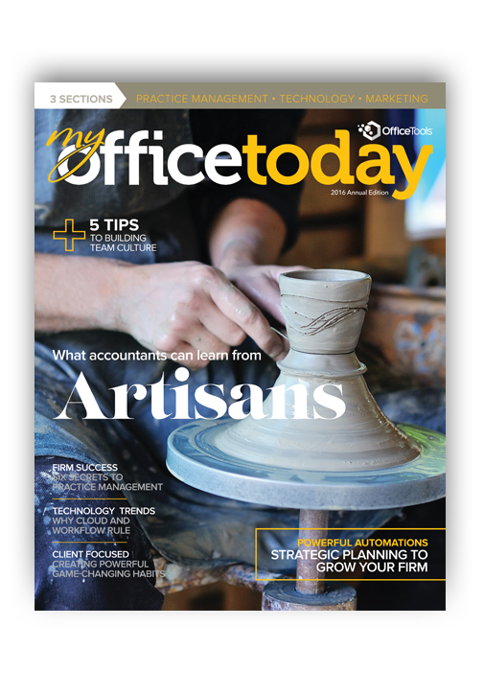
My Office Today
Print distribution 25k
Online distribution 75k
Includes select blogs,
articles and software reviews from industry thought leaders and vendors.
Get your FREE print copy
at www.myofficetoday.me

Slide 7
How to Automate your office on a budget
This session will provide you with guidance
on budgeting and buy in.
We will also detail
Six value added automations
that can help your firm be more
productive and profitable.

Slide 8
How to Automate your office on a budget
WHEN AND HOW DID YOU START YOUR BUSINESS?
Have you built what you hoped you would?
What have we learned over the years?
How do you get back to building something great?

Slide 9
building the dream office

Slide 10
creating the perfect firm

Slide 11
how do i get here?

Slide 12
How to Automate your office on a budget
How do you get back to building something great?
By Planning for the future
and automating firm management

Slide 13
How to Automate your office on a budget
What have we learned over the years?
Planning to automate means embracing the past
the present and the future.
We learn from the past, we live in the now and plan for the future. The past gives us wisdom from our mistakes and successes, and motivates us in planning for the future.
We need to take these lessons and excel in today, and it is the work, actions and plans of today that gives us hope for tomorrow and motivate us to plan for the future.

Slide 14
How to Automate your office on a budget
What have we learned over the years?
It is much wiser to embrace today’s technology without fear and its opportunities through change. Finding a way to automate our software, computers and our internal systems will helps us let go of the past and guarantee future success. Firms who automate now, reap the benefits of renewed success and create future values
of their ultimate asset; their life long business.

Slide 15
How to Automate your office on a budget
LET’S GET STARTED
Going from Good to Great
Budget vs Plan
Six Value Added Automations

Slide 16

Going from good
to great

Slide 17
Going from good
to great
Navigating Change Management
Setting Realistic Goals
Getting Buy-In

Slide 18
Navigating Change Management
Rekindle the goals you had in the beginning
Not staying the same is doing something about it
Change is easy when we have a threat of loss-
Not easy in times of prosperity
We cannot arrive at great without change

Slide 19
Setting Realistic Goals
What can we accomplish in a specific time frame
Most tech takes two years for completely assimilate
Create two and three year plans

Slide 20
Getting Buy-in
Identifying the resisters to change
Using a team to review, analyze and decide
Apply the right level of resources
Financial, time, expertise
Creating a team to deploy, support and toe the line

Slide 21

Budget
vs
plan

Slide 22
Budget
vs
plan
What is the right tech budget?
How will your plans succeed?

Slide 23
What is the Right
Tech Budget?
What % of gross revenue is appropriate?
Does spending more on tech cost the firm more?
What are other firms doing?

Slide 24
What is the Right
Tech Budget?
Randy Johnston, Executive VP K2 Enterprises
“Firms with the most profits per partner spend between 5-7% of the top line revenue. Profits per partner can increase by spending more, but have to be monitored more carefully. If less than 4% of top line revenue is spent, profit per partner will generally be lower than it otherwise could be.”

Slide 25
What is the Right
Tech Budget?
Donny Shimamoto, CPA, CITP, CGMA
Intraprise Technologies LLC
“When you look at the average % spend, remember that it is an average. So if you are spending the same percentage, then you are on par with the average–but is that where your firm wants to be? If you are going to be a leading firm then you should be investing in IT and spending more than the average.”

Slide 26
What is the Right
Tech Budget?
Is a price increase the way to fund tech?
Do you need to spend each year on tech?
What tech is important to you?

Slide 27
How will your plans
Succeed?
Excellence or Mediocrity?
Improving service or reducing time?
Is the money enough?
Do you have time and resources to succeed?
Will one year be enough?
What tech is the most important?

Slide 28







6
value added
automations

Slide 29
6
value added
automations
Data Connecting Products
Online Accounting
Lobby Kiosk Systems
Scan, Fill, Populate Tech
Client Portals
Practice Management Software

Slide 30


Data Connecting
PRODUCTS

Slide 31
CC to GL
Bank Statements to GL
GL to Tax
Eliminate extra databases for office mgmt
Sync Contacts, Tax, Email and Portals

Slide 32

Online Accounting
The CFO Opportunity

Slide 33
Sharing access provides opportunity
Clients expect an expert not a commodity
Increasing our services to existing clients
Creating opportunity to gain more clients

Slide 34

In-Lobby Kiosk Systems
Lobby
Kiosk
Systems

Slide 35
In-Lobby Kiosk Systems
Branding your firm
Setting yourself apart
Saving front office time
Decreasing work load

Slide 36


SCAN
FILL
POPULATE
Technology

Slide 37
Digital Repository – DMS systems
More Monitors - Vertical?
Mark Up Tools
Scan, Fill, Populate

Slide 38

Client
Portals

Slide 39
Sending docs & eSignatures
Creating a client experience
Communications; status updates
Appointment request and reminders
Questionnaires; Organizers
Client updates info & pays invoices

Slide 40

Practice
Management
Software

Slide 41
The Ultimate
Management
ool
T

Slide 42
Cuts down on 50% of meetings
Delegation tool
Accountability tool
Reporting tool
Streamlines workflow
Never miss a due date

Slide 43
The Ultimate
Team
T
ool

Slide 44
Quicker access to information
Reduces interruptions by 60%
Better tracking
Creates error free services
Total time savings
Productivity increases

Slide 45
6
value added
automations
Data Connecting Products
Online Accounting
Lobby Kiosk Systems
Scan, Fill, Populate Tech
Client Portals
Practice Management Software

Slide 46
How to Automate your office on a budget
WORKSPACE™ & WORKSPACE™
ONLINE DEMO

Slide 47

PLAN TO SUCEED
FOLLOW THRU
DON’T GIVE UP

Slide 48
How to Automate your office on a budget
Q & A

Slide 49
How to Automate your office on a budget
THANK YOU FOR ATTENDING
SCHEDULE A WEB DEMO AND PURCHASE IN THE NEXT 7 DAYS AND RECEIVE 20% OFF YOUR PURCHASE.
SIMPLY MENTION THIS PRESENTATION AND DATE.
NOT TO BE COMBINED WITH ANY OTHER OFFERS.

Slide 50
